Slide 1
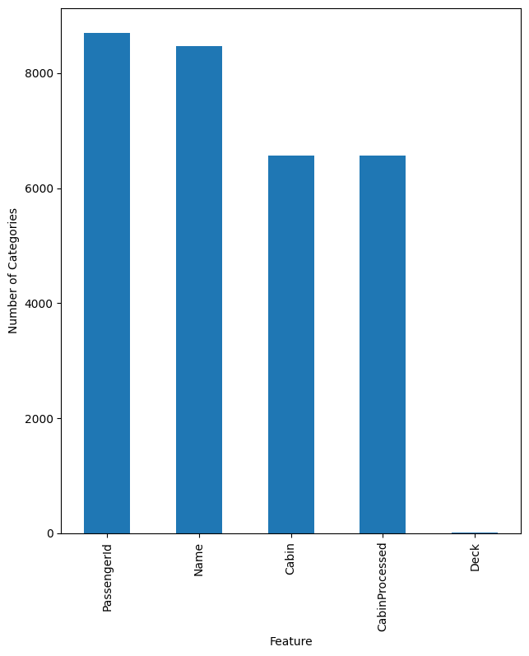
Large Number of Categories
PassengerId (xxxx_yy) is defined as the group number (xxxx) similar to family and the number in the group (yy). Cabin is split into Deck/Num/Side. These transformations have already been done.

Slide 2
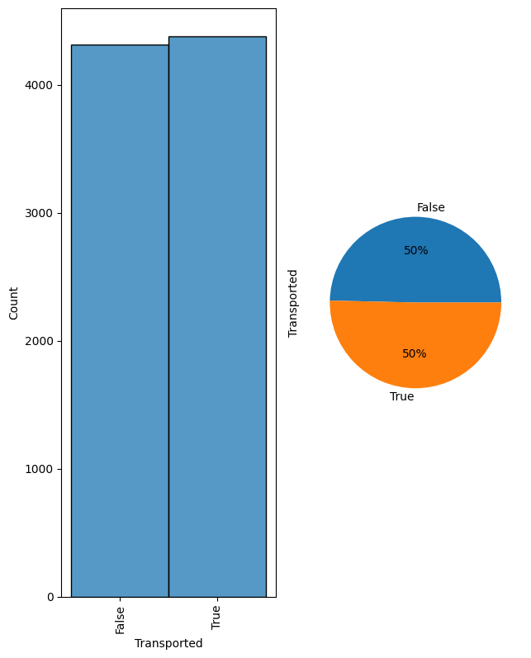
Target
Target feature is the Transported state. We create an encoding so that we can easily identify mean value of transported for different categories.

Slide 3
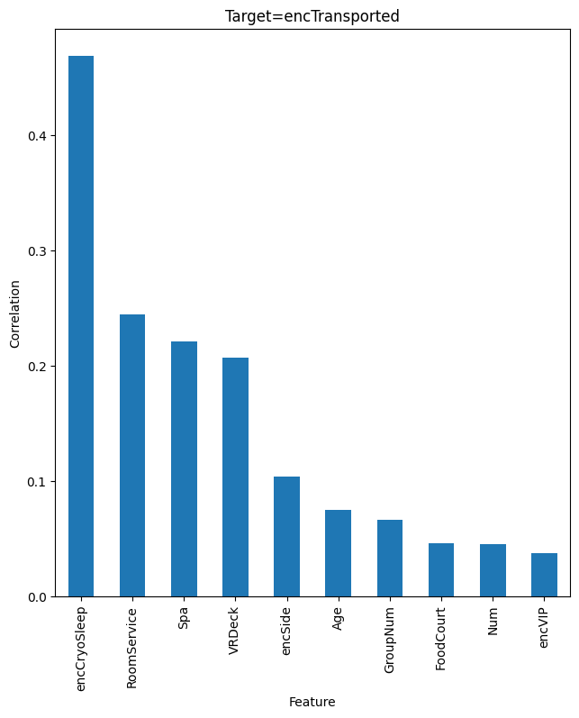
Correlations
After encoding the obvious categories, we can look at which features have the largest immediate correlations.

Slide 4
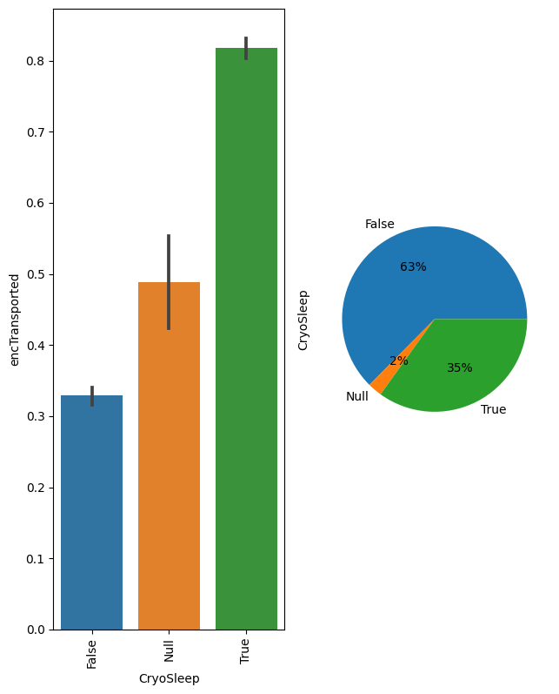
CryoSleep
The largest effect is whether someone was in CryoSleep. This is so dominant that we should account for it as a hue when looking at other variables.

Slide 5
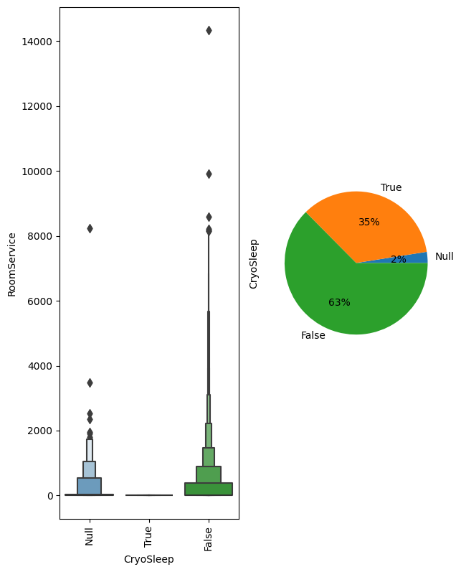
Effects of CryoSleep
Someone can only spend money if they are not in Cryosleep. So the large correlations we see in money spent could easily be due to the fact that CryoSleep is REALLY driving correlation.

Slide 6
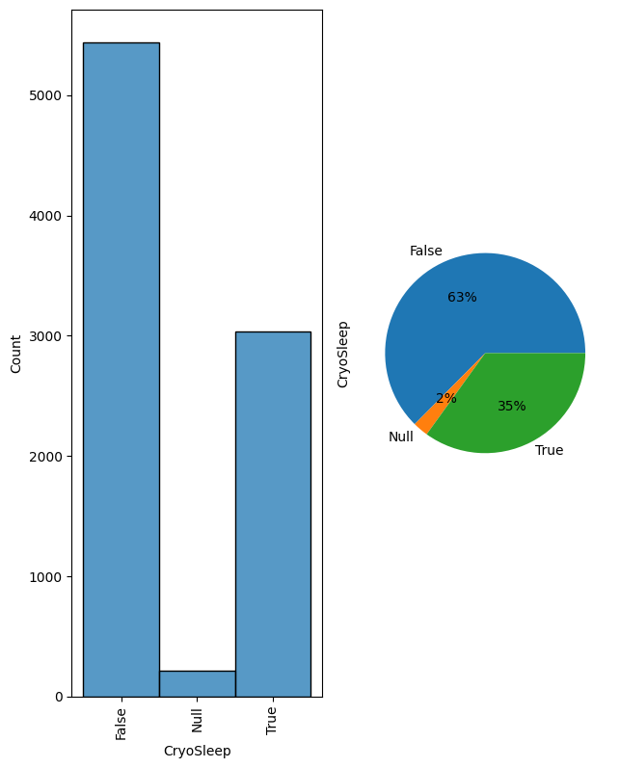
CryoSleep Imputation
We can also impute CryoSleep based on the amount of money spent by the person. (0 is like to be cryosleep).

Slide 7
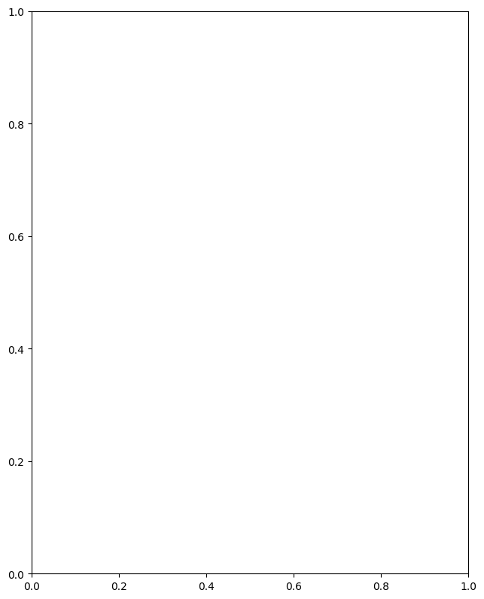
Unknown Feature
It should be investigated whether Name has any bearing on the results. Can we determine male vs female names?

